Slide 1
Syllabus of Unit 1
Introduction ,Need for quality ,Definitions of quality ,Basic concepts of TQM ,TQMFramework ,Barriers to TQM ,Customer focus,Customer orientation ,Customer satisfaction,Customer complaints,Customer retention
INTRODUCTION Quality Concept (CO1)
1.QUALITY AND ITS TYPES
Quality is meeting the customer's needs in a way that exceeds the customer's expectations.
Quality could be defined as a basic tool for a natural property of any good or service that allows it to be compared with any other good or service of its kind. The word quality refers to the set of inherent properties of an object that allows satisfying stated or implied needs.
The following are types of quality
Product Quality
Service Quality
Experience Quality
IT Quality
Data Quality
Information Quality
Quality of life

Slide 2





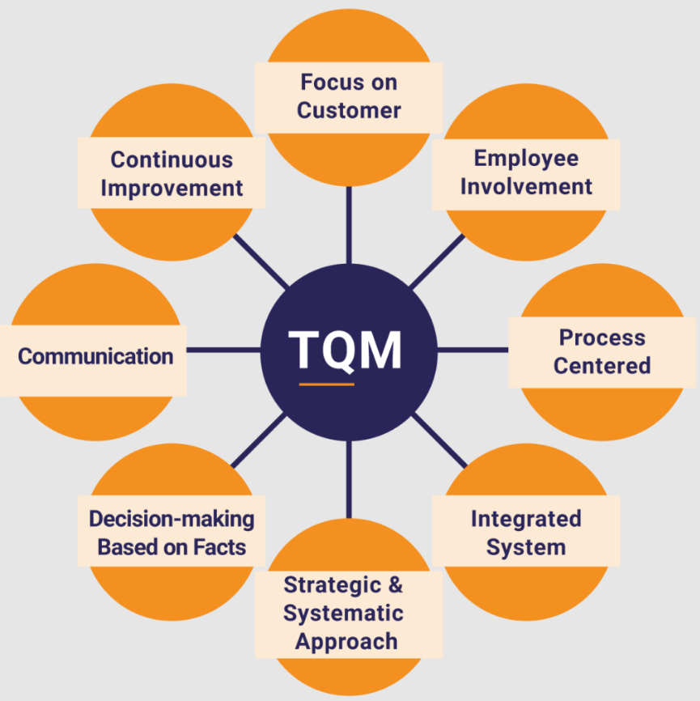
Precap of Quality
External customer
Internal customer
Fulfill customer expectations
Customer's expectations
Customer
In sales, commerce and economics, a customer (sometimes known as a client, buyer, or purchaser) is the recipient of a good service, product or an idea - obtained from a seller, vendor, or supplier via a financial transaction or exchange for money or some other valuable consideration
1. External Customer
People outside the organization who buy or use the product/service.
2. Internal Customer
Employees or departments inside the organization who depend on each other’s work.
3. Fulfill Customer Expectations
Providing products/services according to customer needs and satisfaction.
4. Customer Expectations
The quality, price, service, and performance customers expect from a product or service.

Slide 3
Basic Concept of TQM
Introduction to TQM
Total Quality Management (TQM) is a management approach focused on continuous improvement of products, services, and processes to achieve customer satisfaction.
Key Points
Involves all employees.
Focuses on customer needs.
Emphasizes continuous improvement.
Improves productivity and quality.
Objectives
Customer satisfaction
Defect prevention
Cost reduction
Employee involvement
Implementation principles and processes
of TQM
Implementation Principles of TQM :
Customer Focus
Employee Involvement .
Continuous Improvement
Leadership Commitment
Process of TQM :
Planning – Set quality goals and objectives.
Implementation – Apply quality practices and training.
Evaluation – Monitor and measure performance.
Improvement – Take corrective actions for continuous improvement.
Benefits of TQM
Disadvantages of TQM
Improves product quality
Increases customer satisfaction
Reduces defects and wastage
Increases productivity and profit
High implementation cost
Requires more time and training
Resistance to change by employees
Continuous monitoring is difficult

Slide 4
Principles of TQM- 8 principles
The eight guiding principles that TQM uses to improve quality include the following:
Customer focus. The customer determines the quality level of the products and services. Customer input is valued, as it provides a better understanding of what the customer needs.
Employee involvement. All employees must participate in the processes and system. They must be properly trained and given the needed resources to complete their tasks on time.
3. Focus on process. Processes must be continually analyzed to identify weaknesses. Every employee who takes part in the process should be properly educated in their contributions, ensuring the right steps are taken at the right time.
4. Integrated business systems. All TQM processes should be integrated into a business process. Integrated systems convey potentially useful data across departments, enabling everyone to be on the same page.
5.Strategic and systematic approach. Planning and management are required using a strategic plan with quality as a base component.
6.Continual improvement. A focus on continually improving quality helps an organization adapt to changing markets and achieve competitive advantages.
7. Focus on data. Data should be collected, documented and analyzed to improve decision-making accuracy and to predict trends based on previous history.
8.Communication. Communication between teams with information such as strategies, methodologies or timeliness is essential to improving operations. Good communication can also motivate employees and improve morale.

Slide 5
QM Modern Concept
Quality management is the act of overseeing all activities and tasks needed to maintain a desired level of excellence. Quality management includes the determination of a quality policy, creating and implementing quality planning and assurance, and quality control and quality improvement.
Customer-oriented process
Customer orientation is a business approach that puts the needs of the customer over the needs of the business. Customer-oriented companies understand that the business won't thrive unless it consistently improves customer focus. It's a way of thinking that aligns your business goals with your customers' goals.
Continuous improvement
Continuous improvement, sometimes called continual improvement, is the ongoing improvement of products, services or processes through incremental and breakthrough improvements. These efforts can seek "incremental" improvement over time or "breakthrough" improvement all at once.

Slide 6

Barriers to TQM
TQM Framework
The TQM framework includes the following elements:
Customer Focus
Employee Participation
Continuous Improvement
Process Management
Supplier Quality Management
Performance Measurement
Common Barriers
Lack of top management support
Resistance to change
Poor communication
Lack of employee training
Insufficient resources
Fear of new methods
Improper planning
Customer Focus
Customer focus means understanding and meeting customer needs and expectations.
Features
Identify customer requirements
Deliver quality products
Collect feedback
Benefits
Customer loyalty
Increased sales
Better reputation

Slide 7
Customer Orientation
Customer orientation is the practice of placing customer needs at the center of business decisions.
Characteristics
Quick response to customers
Understanding customer expectations
Providing after-sales service
Building long-term relationships
Advantages
Higher customer trust
Better business growth
Increased competitiveness
Customer Satisfaction
Customer satisfaction is the feeling of happiness when
customer expectations are met.
Factors Affecting Satisfaction
Product quality
Price
Service quality
Employee behavior
Measurement Methods
Surveys
Feedback forms
Reviews and ratings
Complaint analysis
Benefits
Repeat customers
Positive word of mouth
Higher profits

Slide 8
Customer Complaints
Customer Retention
Customer complaints are expressions of
dissatisfaction
about products or services.
Causes
Poor quality
Late delivery
Bad service
Defective products
Complaint Handling Steps
Listen carefully
Identify the problem
Provide solution
Follow up with customer
Customer Retention
Customer retention means keeping existing customers for a long period.
Methods to Retain Customers
Provide good quality
Offer excellent service
Handle complaints quickly
Maintain good relationships
Advantages
Stable profits
Strong customer loyalty
Importance
Helps improve quality
Identifies weaknesses
Builds customer trust

Slide 9
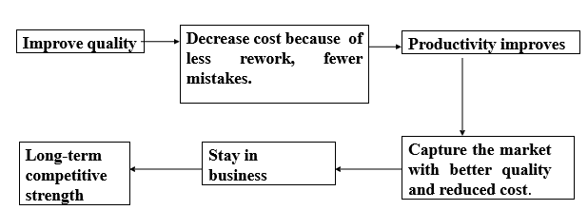
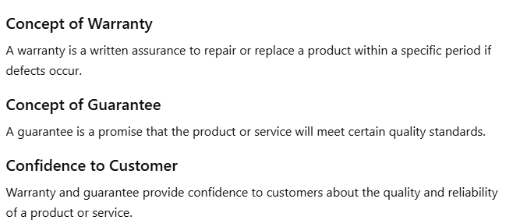
Evolution of QM Philosophies (CO1)
The Deming Philosophy
Definition of quality, “A product or a service possesses quality if it helps somebody and enjoys a good and sustainable market.”
Prerequisite of Deeming

Slide 10
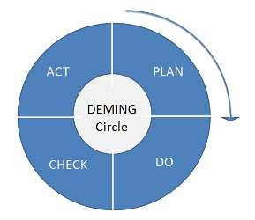
Deming Point (CO1)
Deming’s 14 points for Management were first presented in his book Out of the Crisis. With the 14 important management principles he offered a way to drastically improve the company’s effectiveness. Many of these management principles are philosophical in nature, and some are more programmatic.
All Deming’s 14 points for Management can bring about transformation. Below you will find a short description of the 14 points:
” father of statistical quality control .".
PDCA :
Plan the improvement
Do and start the change
Check the results of improvement
Act to hold the gain or start again.

Slide 11
W. Edwards Deming 14 Points
Create constancy of purpose – Focus on continuous improvement of products and services.
Adopt new philosophy – Accept change and modern quality methods.
Cease dependence on inspection – Improve quality during the process itself.
End lowest tender contracts – Build long-term relationships with suppliers.
Continually improve processes – Always seek ways to improve quality and productivity.
Institute training on the job – Provide proper employee training regularly.
Institute leadership – Managers should guide and support employees effectively.
Drive out fear – Create a safe and open work environment.
Break down barriers – Encourage teamwork between departments.
Eliminate slogans – Avoid unrealistic targets and pressure slogans.
Eliminate numerical targets – Focus on quality instead of only numbers.
Permit pride of workmanship – Allow employees to take pride in their work.
Institute education and self-improvement – Encourage learning and development.
Transformation is everyone’s job – Every employee should participate in quality improvement.

